Slide 1

Bienvenue dans notre projet ^^

Slide 2





Les membres du groupe
Youssef Ben Arous
Fares Ben Ammar
Jasser Yahmadi
Raslen Ferchichi
Ala Bouchakour

Slide 3
Table of Contents
1
Chosen Theme
2
Competitor Sites
3
Diagrams
4
Module Distribution
5
Graphic Elements
6
Template
What is barter ?
Why are we doing it?
Top 3 most used exchange/barter websites
How can we surpass them?
General use case diagram
Detailed use case diagram
How we chose the modules & How we distributed them
Logo
Chosen colors
Front
back

Slide 4
Chosen Theme
01.
What Is Bartering?

Slide 5
Définition du troc !
Bartering is an exchange between two people that allows you to get rid of items you no longer need in exchange for other items you do need. It is, in fact, a cost-free, economical, and… ecological operation. Every item exchanged means one less piece of waste. So instead of throwing it away, dive into bartering!

Slide 6

Why Do We Do It?
Beyond creating connections or simply establishing human solidarity, bartering allows some people to obtain items or carry out projects they couldn’t afford without exchanging goods or skills. Moreover, items that others might throw away are recovered by someone else, helping reduce waste and providing for those in need. Objects get a second life instead of being discarded, and the best part is that everyone benefits without spending a single euro! A great way to leave with a smile.

Slide 7
Competitor Sites
02 .

Slide 8
Top 3 Barter websites

Slide 9
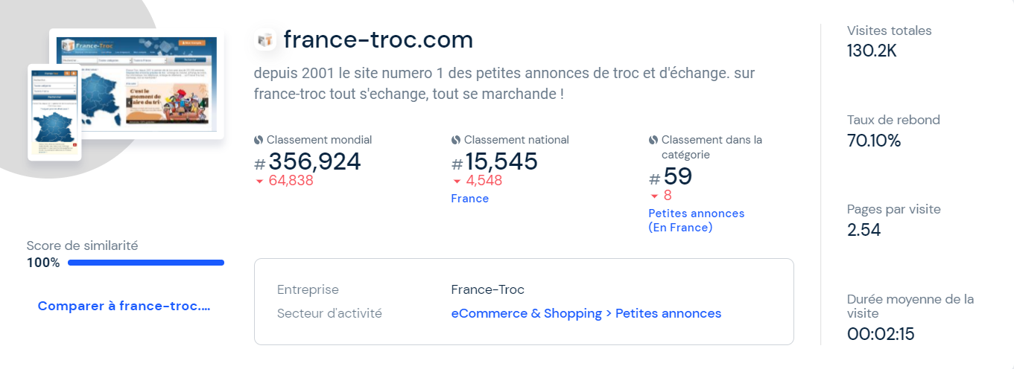

Slide 10
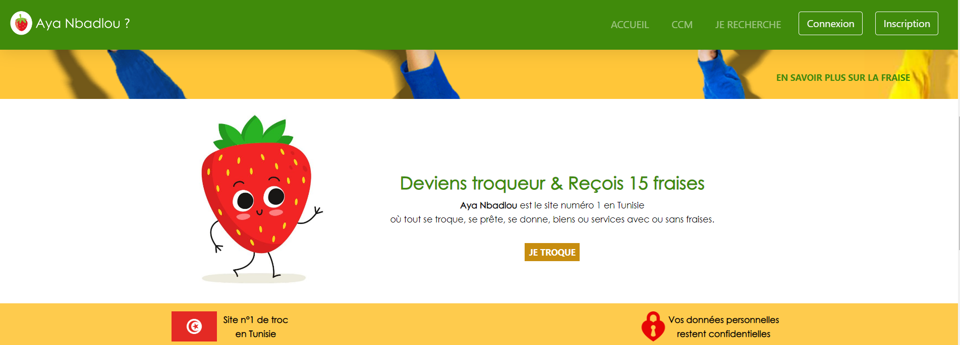

Slide 11
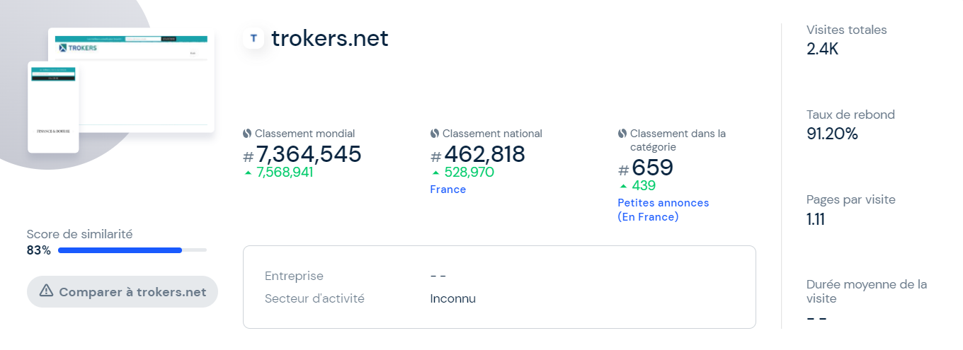

Slide 12

www.tchangi.com
Here is the Name of the Website We Are Going to Create

Slide 13
How Will We Surpass Them?
security
Menu
The menu will be extremely easy to navigate.
Your Account and Personal Information Will Be Completely Secure
Quality
We work to provide you with the best offers.

Slide 14
Diagrams
03 .
Project Study

Slide 15
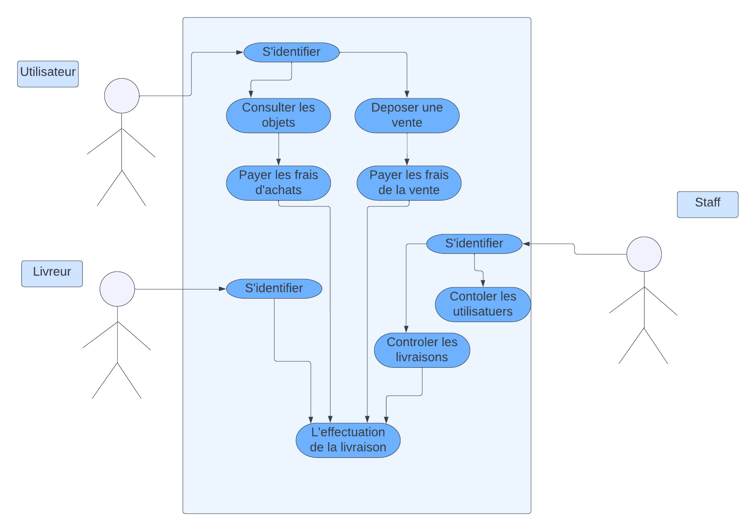
Global Diagram

Slide 16
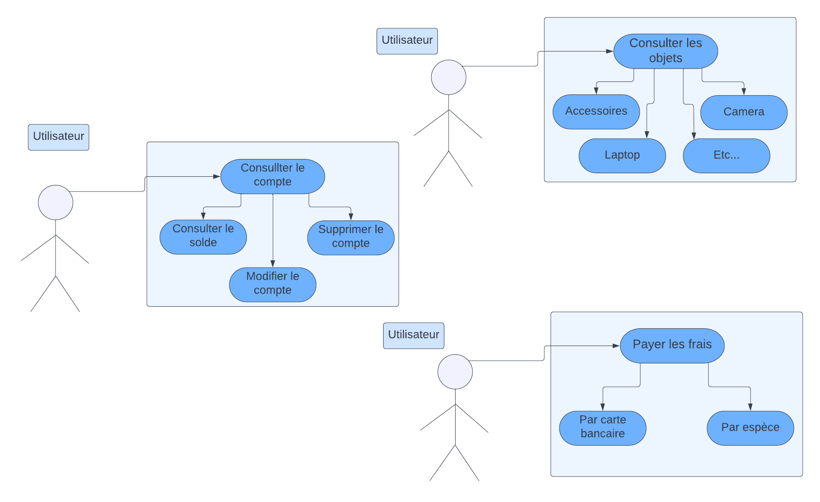
User Scenario Study

Slide 17
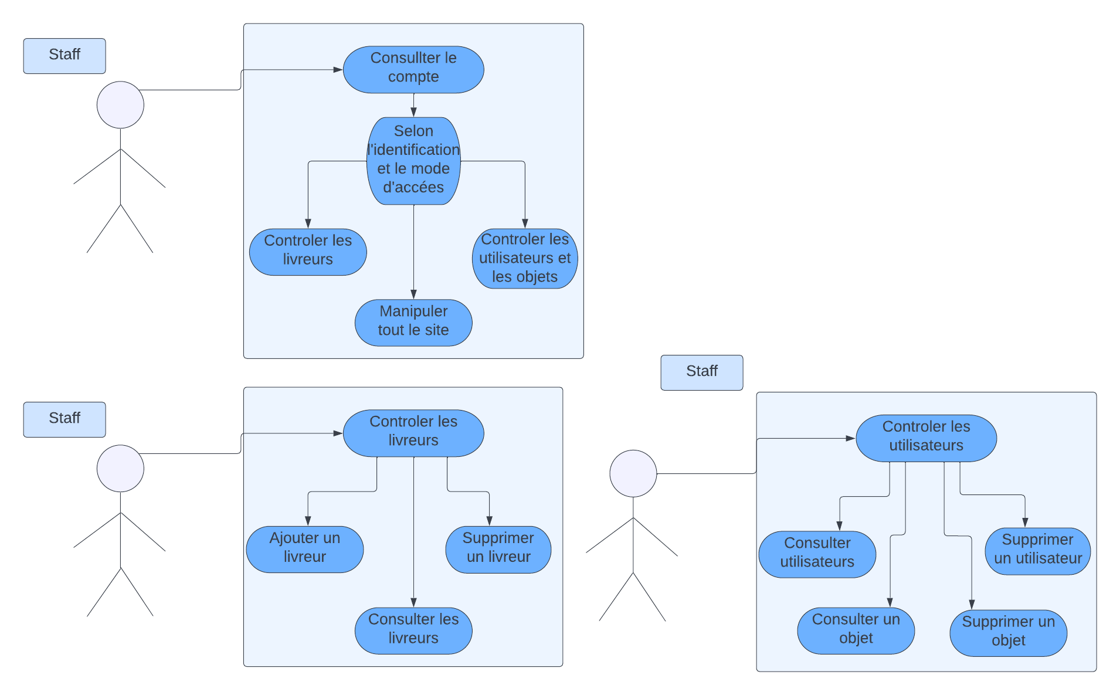
Staff Scenario Study

Slide 18
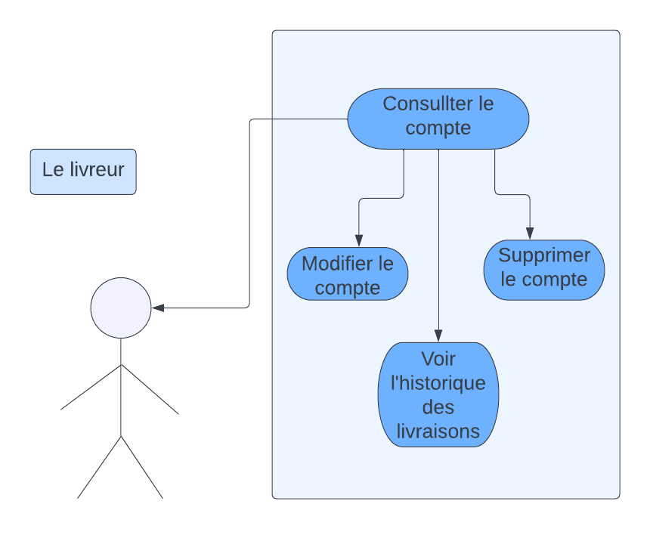
Delivery Scenario Study

Slide 19
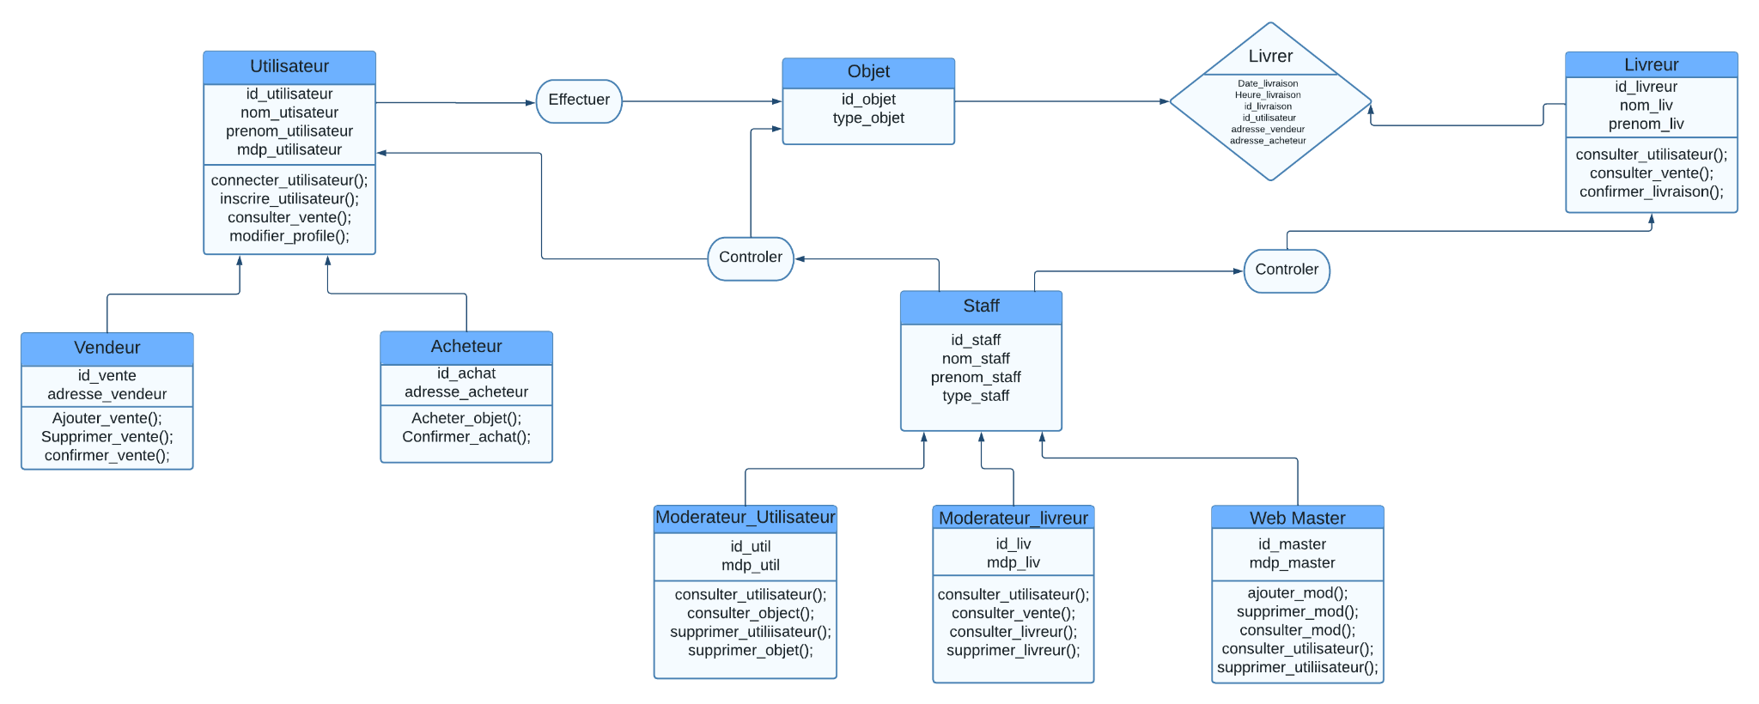
Class Diagram

Slide 20
Module Distribution
04 .
Work Organization

Slide 21

4.1 Client Management
Entity
Client
User
Administrator
CRUD
- Add a client
- Delete a client
- View a client
Features
-View complaints
-View purchase and sales history

Slide 22
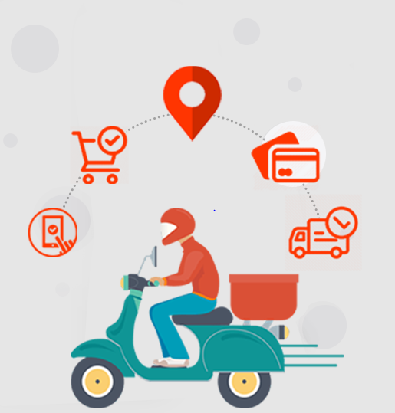
4.2 Delivery Management
Entity
Delivery Person
User
Administrator / Clients
CRUD
Deliver products
Contact the delivery person
Operations / Features
View complaints
View purchases

Slide 23
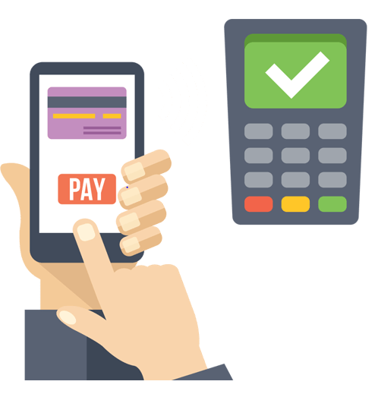
4.3 Payment Management
Entity
Client User Clients
CRUD
Add a new invoice Delete an invoice Display an invoice
Operations / Features
Generate electronic invoices View purchase history

Slide 24

4.4 Administrative Management
Entity
Client / Delivery Person User Administrator
CRUD
View or delete a delivery person View or delete a client Manage items
Operations / Features
Monitor delivery persons Monitor clients Monitor items

Slide 25

4.5 Purchase Management
Entity
Client
User
Client
CRUD
View or delete an item
Manage items
Operations / Features
Manage items

Slide 26
Graphic Charter
05 .
Design Section

Slide 27


Charte graphique
LOGO :
SLOGAN :

Slide 28





Used colors
#ffffff
#e50a2e
#d31838
#15161d

Slide 29

